Slide 1
Session 3
INNER HEALING AND SPIRITUAL WARFARE

Slide 2
INNER HEALING
…is a release from pain. Psalm 147:3
…is correction of ungodly responses to past hurts & memories. Romans 12:19
…is a reframing or reinterpreting of a past event. Romans 8:28
…is an exchange of past negative effects for positive ones. Isaiah 61:3
….is generally a process

Slide 3
FORGIVENESS 1

Slide 4
FORGIVENESS 2

Slide 5
“She bore a child when she was past the age because she judged God faithful who had promised.”
Hebrews 11:11

Slide 6
GRIEF – TWO KINDS
1. Chronic Grief
Generally happens at loss of parent &/or “Mother Wounding”
When early in life, grief is “incremental”

Slide 7
GRIEF – TWO KINDS
2. Acute Grief
From event that stunts person’s growth emotionally, spiritually, relationally
Happens at a specific time or times

Slide 8
GRIEF – TWO KINDS
Grief produces things like Anxiety, Depression, Chronic Fatigue Syndrome, Fibromyalgia, PSTD

Slide 9
MINISTERING TO GRIEF
1. Find the ROOT – What? When? Go to first or worst event
2. Help the person relax
3. Ask God to reveal memories – recent to past, or visa versa
4. Pray for the physical & emotional effects from each memory-minister to how person processed the trauma, not the trauma
5. Extract painful memory & replace with God’s Truth so Jesus can rewrite the narrative
6. Ask Jesus to fill person with His Peace- mentally, emotionally AND physically.

Slide 10
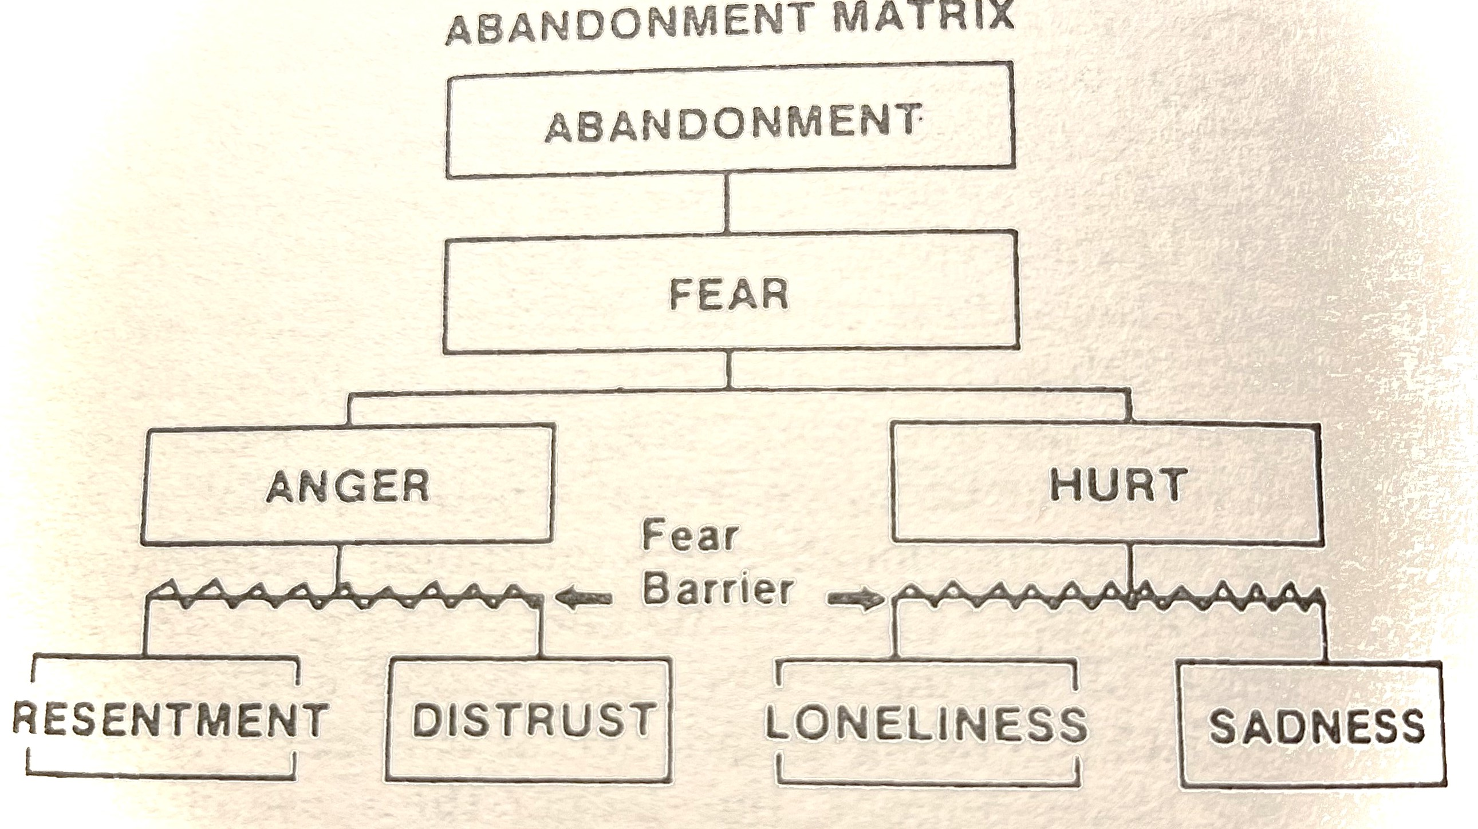

Slide 11
PRIMAL WOUND
A WOUND WHICH IS PHYSICAL, EMOTIONAL, PSYCHOLOGICAL AND SPIRITUAL ALMOST TO A CELLULAR LEVEL.
“…that the child does not consciously remember the separation at birth does NOT diminish the impact of it.”

Slide 12
WOUNDING IN UTERO
Catherine Monk, Professor of Medical Psychology in Psychiatry and Obstetrics and Gynecology at Columbia University Irving Medical Center
“…some fetuses register the mother’s stress, depression, and anxiety as early as four months in utero.”

Slide 13
WOUNDING IN UTERO
Extended Financial or Emotional Stress
Unplanned or Unwanted Pregnancy
Partner Abandonment
Physical Sickness of Mother

Slide 14
INTEGRATED HEALING-BODY, SOUL, SPIRIT
“Anxiety in a man’s heart weighs him down, but a good word makes him glad.” Proverbs 12:25
“ A cheerful heart is good medicine, but a crushed spirit dries up the bones.” Proverbs 17:22

Slide 15
Toxic Thoughts & Suppressed Emotional Pain can turn into physical ailments.
Researchers say that 87% of the illnesses that plague us today are the result of toxic thoughts and toxic emotions. (anger, rage, self hatred, unforgiveness, etc.) Dr. Caroline Leaf-Christian Researcher, Writer, Lecturer focusing on the brain
Lethargy, Anxiety, Insomnia, Panic Attacks, Exhaustion, Fatigue, Headaches/Migraines

Slide 16
Revelation 21:4
“And God will wipe away every tear from their eyes; there shall be no more death, nor sorrow, nor crying. There shall be no more pain, for the former things have passed away.”

